Slide 1
Survival Analytics
Concepts & Code

Slide 2
Contents
Definitions
Motivation
Formal Definitions
Models with Code Examples
Non-Parametric - Kaplan Meier
Parametric – Weibull

Slide 3
Definitions of Some Terms
Birth Event: the start of observation period in a study.
Example: the start of a shift in a factory
Death Event: the occurrence of an event under consideration.
Example: failure of a machine
Censorship: the case where we do not have complete information about the either the birth or the death event of a sample.
Left Censorship: when the birth event was not observed. Example: a machine was on before the shift started
Right Censorship: when the death event is not observed by the end of study. Example: some machines did not fail by the end of the shift.
Survival Function: the probability that the event of interest has not occurred at time t as function of time t. It can also be interpreted as the probability of survival after time t.
Hazard Function: the probability that the event of interest will occur within a small interval of time or the instantaneous rate of occurrence of the event.

Slide 4
Motivation
Survival analysis was initially used by medical practitioners and actuaries to deal with problems such as:
What is life expectancy of patients in cohort A as compared to cohort B (where one of the cohorts would be given a drug under study)?
What is the life expectancy of the population in Gurgaon?
However these methods/models are now used for variety of tasks such as to determine machine failure time, customer churn duration.
These models are different from the regression model in the following way:
Survival analysis is specially designed to handle data censorship
In survival analysis we aim to derive the survival/hazard functions unlike lifespan values for individual samples as in a regression setup.

Slide 5
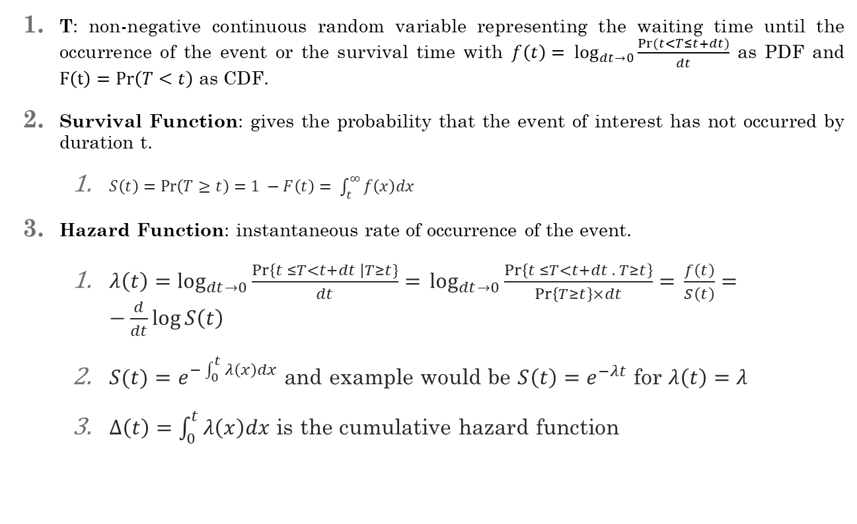
Formal Definitions
T: non-negative continuous random variable representing the waiting time until the occurrence of the event or the survival time with $f\left(t\right)= \log_{dt→0}{\frac{Pr⁡(t<T≤t+dt)}{dt}}$ as PDF and $F\left(t\right)=\operatorname{Pr}\left(T<t\right)$ as CDF.
Survival Function: gives the probability that the event of interest has not occurred by duration t.
$S\left(t\right)=\operatorname{Pr}\left(T≥t\right)=1 −F\left(t\right)= \int_{t}^{∞}{f\left(x\right)dx}$
Hazard Function: instantaneous rate of occurrence of the event.
$λ\left(t\right)=\log_{dt→0}{\frac{\operatorname{Pr}\left\{t ≤T<t+dt \right|T≥t\}}{dt}= }\log_{dt→0}{\frac{\operatorname{Pr}\left\{t ≤T<t+dt . T≥t\right\}}{\operatorname{Pr}\left\{T≥t\right\}×dt}= }\frac{f\left(t\right)}{S\left(t\right)}=−\frac{d}{dt}log⁡S\left(t\right)$
$S(t)=e^{−\int_{0}^{t}{λ\left(x\right)dx}}$ and example would be $S\left(t\right)=e^{−λt}$ for $λ\left(t\right)=λ$
$Δ\left(t\right)=\int_{0}^{t}{λ\left(x\right)dx}$ is the cumulative hazard function

Slide 6


Slide 7
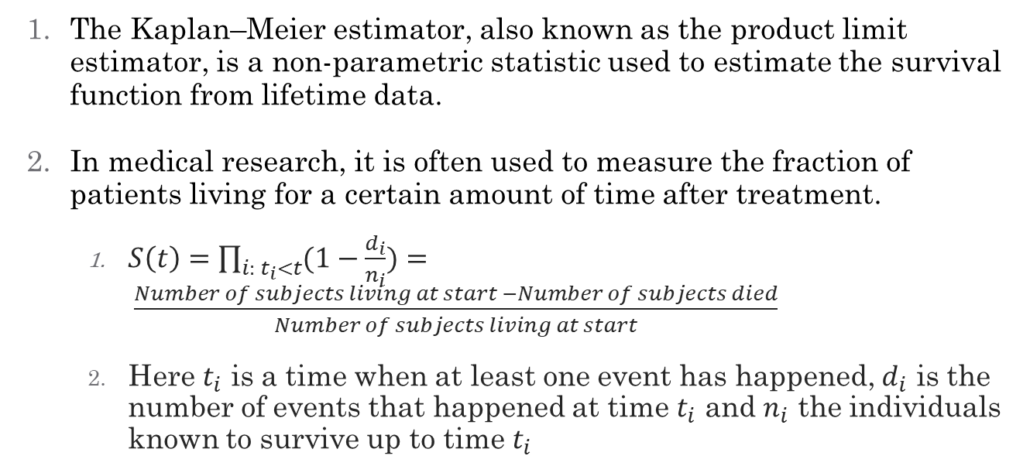
Non-Parameter Models: Kaplan-Meier
The Kaplan–Meier estimator, also known as the product limit estimator, is a non-parametric statistic used to estimate the survival function from lifetime data.
In medical research, it is often used to measure the fraction of patients living for a certain amount of time after treatment.
$S\left(t\right)=\prod_{i: t_{i}<t}{(1−\frac{d_{i}}{n_{i}}})= \frac{Number of subjects living at start −Number of subjects died}{Number of subjects living at start}$
Here $t_{i}$ is a time when at least one event has happened, $d_{i}$ is the number of events that happened at time $t_{i}$ and $n_{i}$ the individuals known to survive up to time $t_{i}$

Slide 8
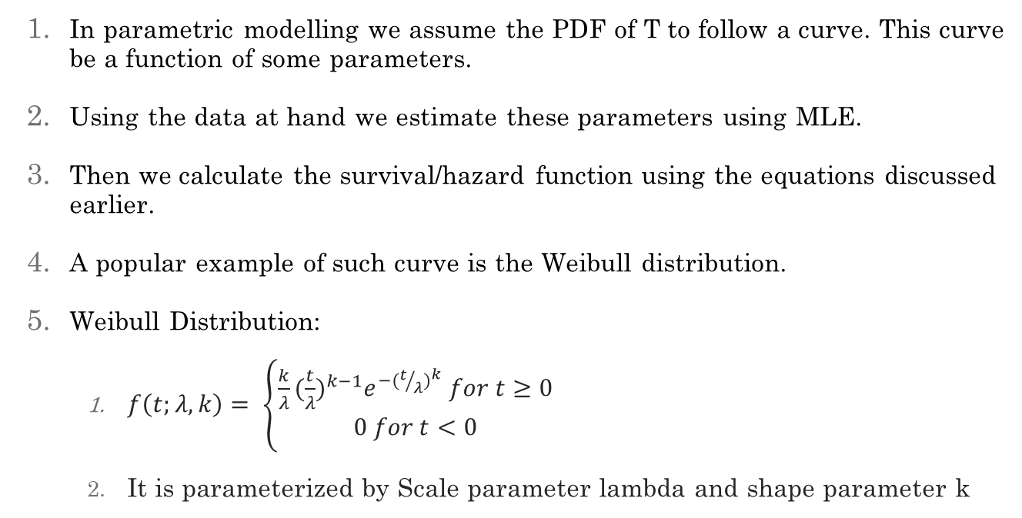
Parametric Models: Weibull Curve
In parametric modelling we assume the PDF of T to follow a curve. This curve be a function of some parameters.
Using the data at hand we estimate these parameters using MLE.
Then we calculate the survival/hazard function using the equations discussed earlier.
A popular example of such curve is the Weibull distribution.
Weibull Distribution:
$f\left(t;λ, k\right)= \left\{\begin{aligned}\frac{k}{λ}{(\frac{t}{λ})}^{k−1}e^{−{(t/λ)}^{k}} for t≥0 \\ 0 for t<0\end{aligned}\right.$
It is parameterized by Scale parameter lambda and shape parameter k

Slide 9
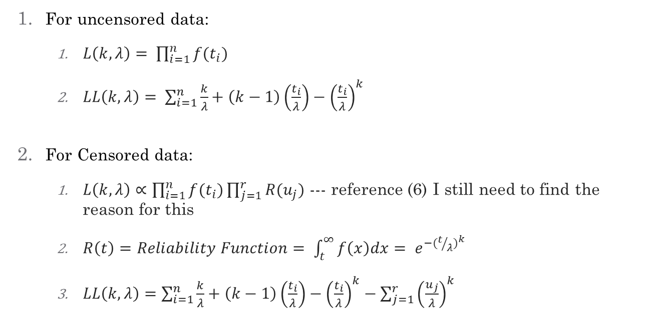
Maximum Likelihood Estimation
For uncensored data:
$L\left(k, λ\right)= \prod_{i=1}^{n}{f(t_{i})}$
$LL\left(k, λ\right)= \sum_{i=1}^{n}{\frac{k}{λ}+\left(k−1\right)\left(\frac{t_{i}}{λ}\right)−{\left(\frac{t_{i}}{λ}\right)}^{k}}$
For Censored data:
$L\left(k, λ\right)∝\prod_{i=1}^{n}{f(t_{i})\prod_{j=1}^{r}{R(u_{j})}}$ --- reference (6) I still need to find the reason for this
$R\left(t\right)=Reliability Function= \int_{t}^{∞}{f\left(x\right)dx= e^{−{(t/λ)}^{k}}}$
$LL\left(k, λ\right)=\sum_{i=1}^{n}{\frac{k}{λ}+\left(k−1\right)\left(\frac{t_{i}}{λ}\right)−{\left(\frac{t_{i}}{λ}\right)}^{k}}−{\sum_{j=1}^{r}{\left(\frac{u_{j}}{λ}\right)}}^{k}$

Slide 10
References
https://www.youtube.com/watch?v=fli-yE5grtY
https://speakerdeck.com/lindauruchurtu/survival-analysis-in-r-and-python?slide=17
https://stats.stackexchange.com/questions/55118/cox-model-vs-logistic-regression
https
https://stats.stackexchange.com/questions/58046/proof-of-relationship-between-hazard-rate-probability-density-survival-functio
https://csce.ucmss.com/books/LFS/CSREA2017/PDP2059.pdf
https://pdfslide.net/documents/maximum-likelihood-estimation-in-the-weibull-distribution-based-on-complete.html
https://www.ncbi.nlm.nih.gov/pmc/articles/PMC3059453/
https://rmvpaeme.github.io/KaplanMeier_intro/#
http://savvastjortjoglou.com/nfl-survival-analysis-kaplan-meier.html
For Python Users: https://lifelines.readthedocs.io/en/latest/Survival%20Analysis%20intro.html
For R Users: https://www.r-bloggers.com/survival-analysis-part-i/

